Slide 1
GATEWAY
Internal | Duong Cao Trong Nhan (RBVH/EJV24) | 07/24/2023

Slide 2
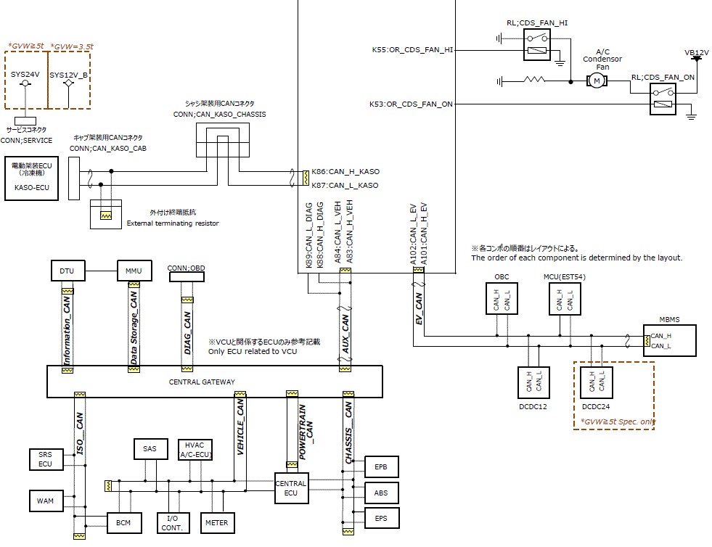
Overview
VCU
Gateway
Tester
CGW
Customer requirement: while flashing new software is happen between Tester and VCU, lower ECUs can still continue to work and communicate with the Tester via the VCU as a gateway.
Internal | Duong Cao Trong Nhan (RBVH/EJV24) | 07/24/2023.

Slide 3
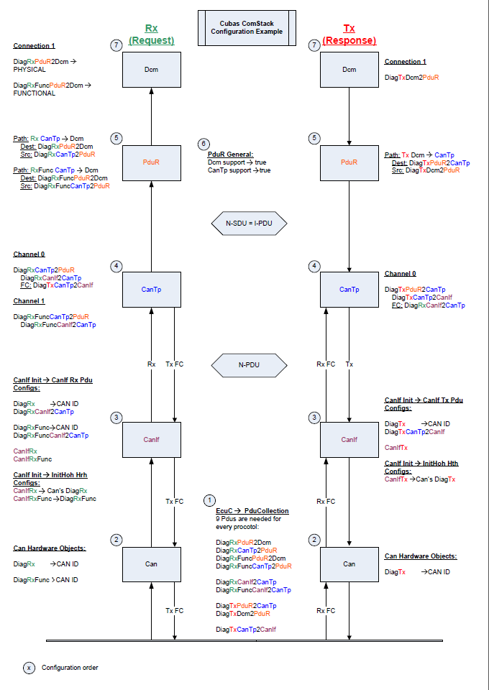
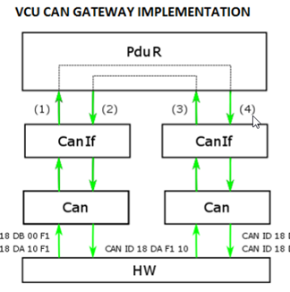
Solution
CAN→ CANIf → CanTp → PduR→ DCM
CAN→ CANIf → PDUR → another CANIf → CAN
Changing the concept mapping in each layers with gateway messages
Diagnostic messages: CAN→ CANIf → CanTp → PduR→ DCM
Gateway messages: CAN→ CANIf → PDUR → another CANIf → CAN
Internal | Duong Cao Trong Nhan (RBVH/EJV24) | 07/24/2023.

Slide 4
Solution
How the signal is handled through the layers for the gateway
Gateway messages: CAN→ CANIf → PDUR → another CANIf → CAN
PDUR
CanIf
PduRDestdu
PDU
CAN Driver
HTH
HTH
HRH
HRH
PduRSrcPdu
PDU
Routing Table
CAN Controller 1
CAN Controller 2
Mailbox
HW Object
Mailbox
HW Object
CAN Transceiver 1
CAN Transceiver 2
Internal | Duong Cao Trong Nhan (RBVH/EJV24) | 07/24/2023.

